Slide 1

The Nexthikes Project
Real Estate Price Prediction via Feature Engineering
Presented by VARUN

Slide 2

The Real Estate Pricing Challenge
Understanding property values requires more than intuition—it demands systematic data analysis. This guide walks through the complete workflow for pricing real estate using Python, from loading raw data to extracting actionable insights that drive pricing decisions.
Each step builds upon the previous one, creating a comprehensive analytical framework that transforms raw property data into strategic pricing intelligence.

Slide 3

Step 1: Loading the Data
Foundation of Your Analysis
Begin by loading your real estate dataset into a Pandas DataFrame, the fundamental data structure for analysis. Whether your data lives in CSV, Excel, or a database, Pandas provides efficient tools to import and structure it.
Key considerations:
Verify file paths and format specifications
Check initial data shape and structure
Inspect data types for each column
Handle encoding issues if present

Slide 4

Step 2: Cleaning the Data
Missing Values
Duplicate Entries
Data Anomalies
Identify and handle missing data systematically. Use statistical methods or domain knowledge to impute values, or drop records if appropriate.
Remove duplicate property listings that can skew your analysis. Check for identical records or near-duplicates with minor variations.
Detect and address outliers and inconsistencies. Validate price ranges, square footage, and other key metrics for logical values.
Data quality is paramount—clean datasets lead to reliable insights and accurate pricing models.

Slide 5

Step 3: Univariate Analysis
Start by exploring individual variables to understand their distributions and characteristics. This foundational analysis reveals patterns in key metrics like house prices, square footage, and property ages.
01
02
Generate Distributions
Calculate Statistics
Create histograms and kernel density plots to visualize variable distributions
Compute mean, median, standard deviation, and quartiles for each variable
03
Identify Patterns
Spot skewness, outliers, and unusual patterns that may require attention

Slide 6
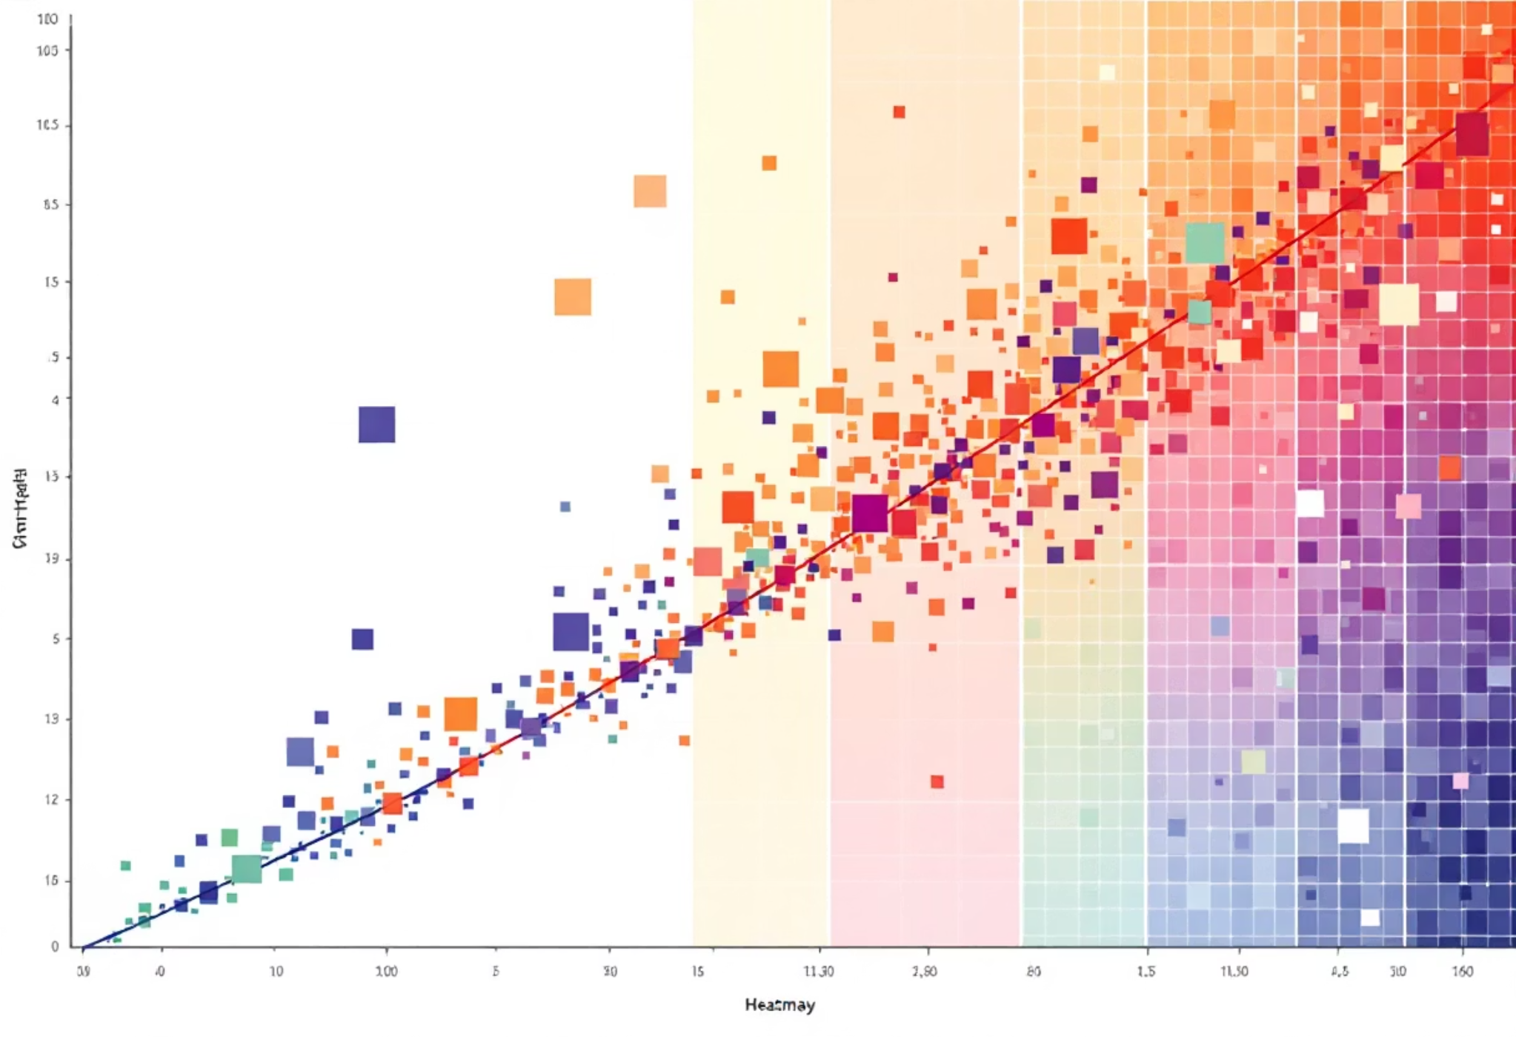
Step 4: Multivariate Analysis
Understanding Relationships
Move beyond single variables to explore how features interact and influence house prices. Multivariate analysis reveals correlations and dependencies that drive property valuation.
Essential techniques:
Correlation matrices to quantify relationships
Scatterplot matrices for visual exploration
Pairwise comparisons of key features
Heatmaps to highlight strong correlations
Identify which features—bedrooms, location, amenities—have the strongest impact on price.

Slide 7

Step 5: Feature Engineering
Enhance your dataset by creating new features that capture meaningful information for pricing analysis. These engineered variables often prove more predictive than raw data.
1
Price per Square Foot
Calculate unit pricing to normalize property values across different sizes and enable meaningful comparisons
2
Property Age
Derive age from construction year to assess how property vintage affects market value
3
Price Category
Bucket prices into ranges to identify market segments and tier classifications
4
Feature Combinations
Create interaction terms that capture synergies between multiple attributes

Slide 8
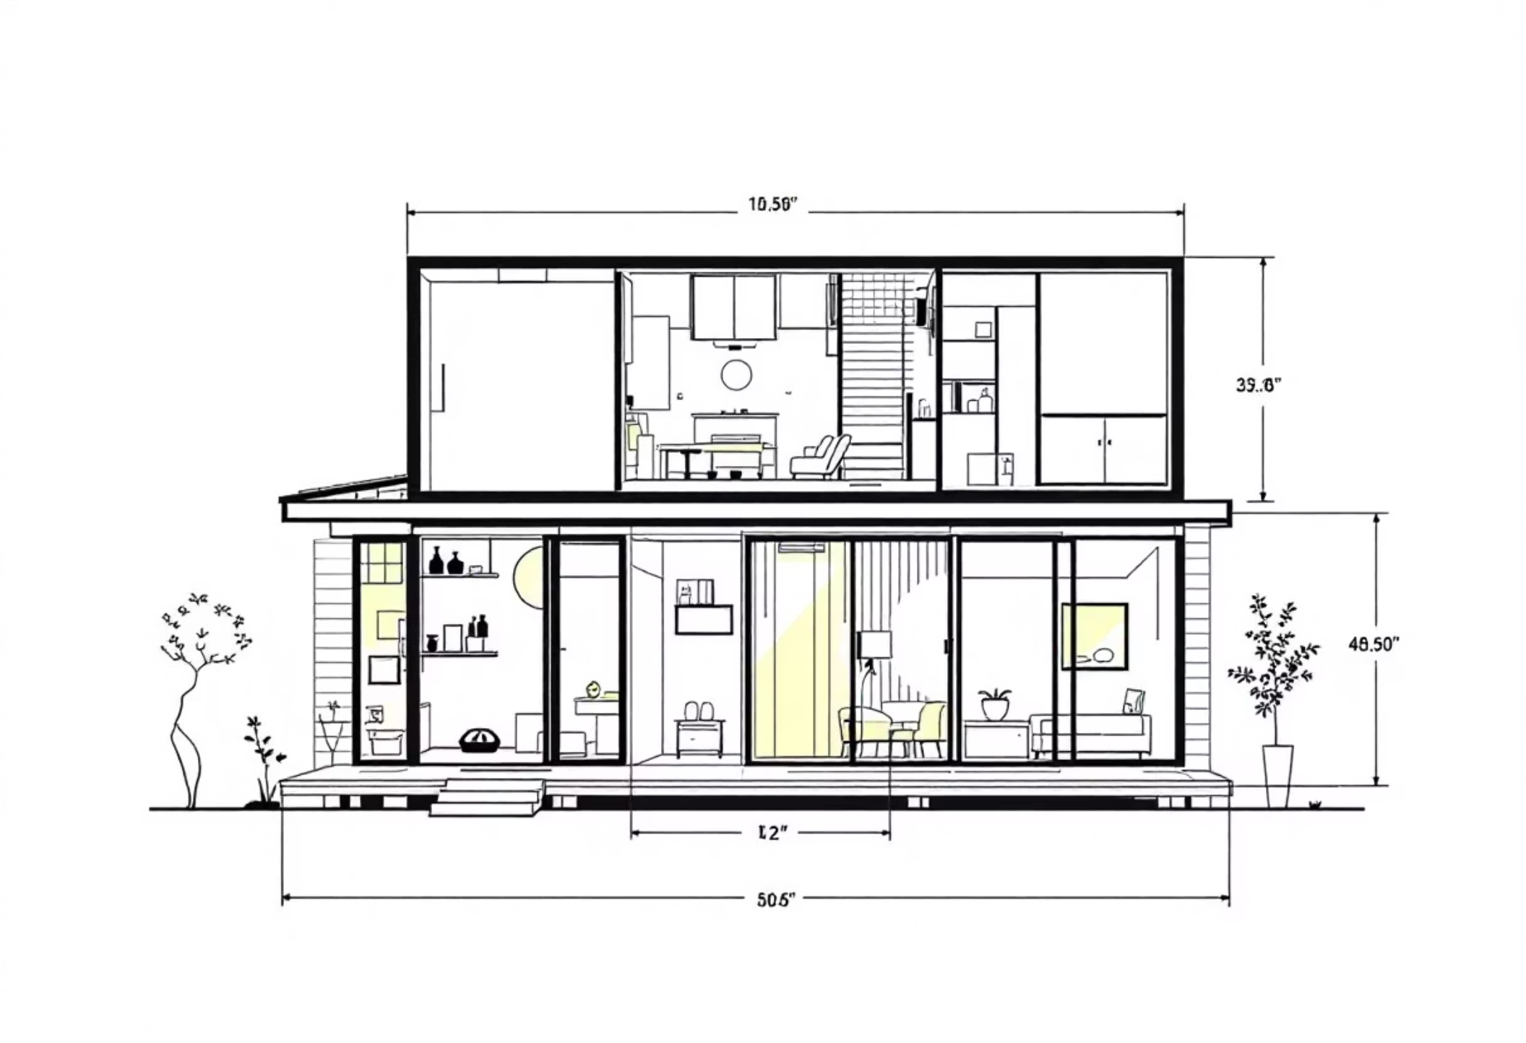
Step 6: Size Impact Analysis
Key Features Matter
Delve deeper into how property characteristics collectively influence pricing. Analyze relationships between bedrooms, bathrooms, square footage, lot size, and their combined effect on valuation.
Regression analysis to quantify feature impact
Group comparisons across property types
Size-to-price ratios by neighborhood
Interaction effects between features
Understanding these relationships helps you build accurate pricing models and identify undervalued properties.

Slide 9

Step 7: Market Trends and Historical Pricing
1
Time Series Analysis
Plot prices over time to visualize historical trends and seasonal patterns
2
Period Comparisons
Compare pricing across quarters, years, or market cycles
3
Economic Context
Overlay external factors like interest rates and employment data
4
Forecasting
Use historical patterns to project future pricing movements
Temporal analysis reveals how market conditions shape pricing dynamics and helps you time property sales or purchases strategically.

Slide 10

Step 8: Amenities and Customer Preferences
What Drives Premium Pricing?
Investigate how specific amenities and customer preferences impact house prices. Analyze property features like swimming pools, garages, outdoor space, and modern conveniences to quantify their value.
Approach:
Compare prices of properties with and without amenities
Analyze customer reviews for perceived value insights
Calculate premium percentages for each feature
Identify highest-value amenities in your market
32%
2.5x
$15K
Pool Premium
Garage Value
View Premium
Average price increase with pool
Price per square foot comparison
Average scenic view value

